Slide 1

Israel

Slide 2
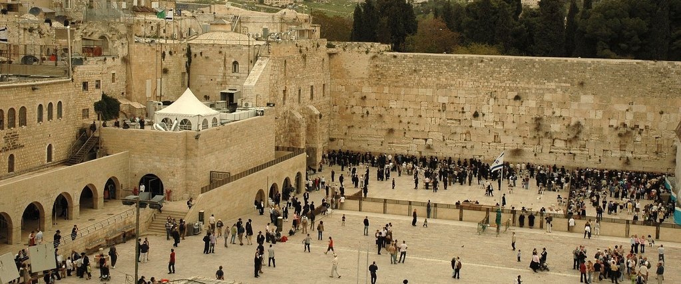
Notes:
Western Wall

Slide 3
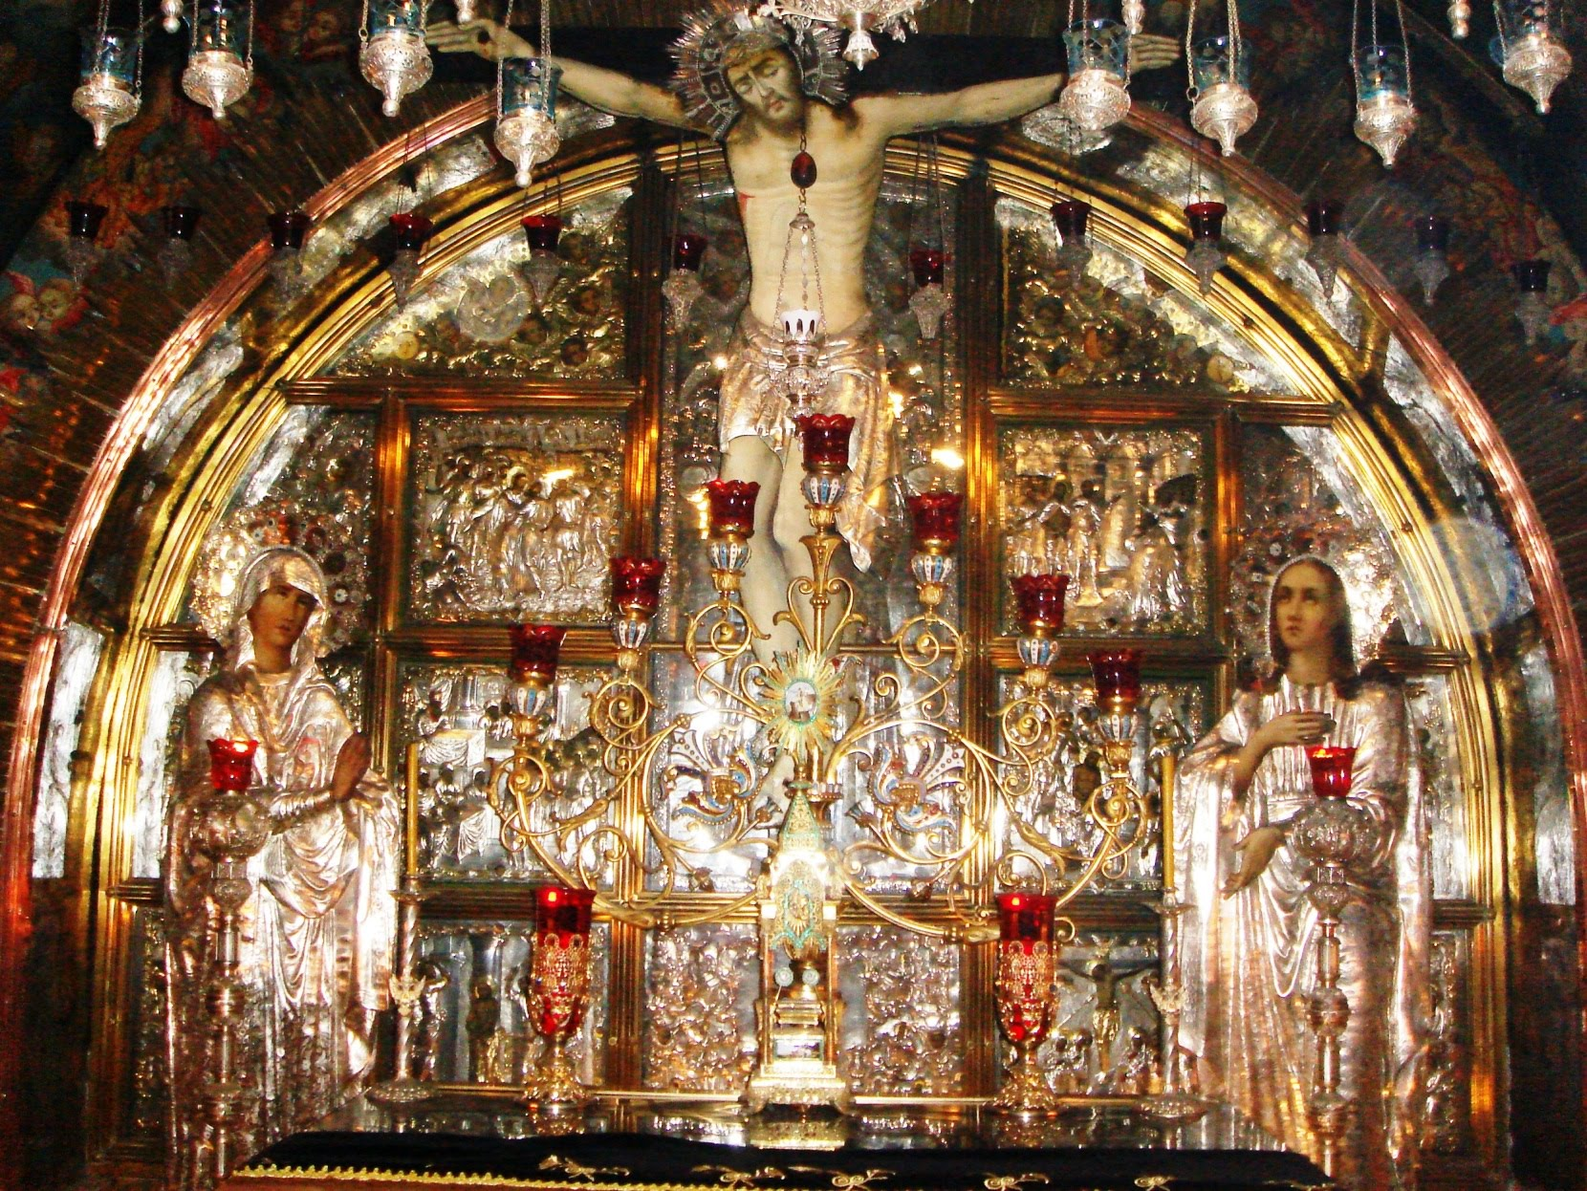
Notes:
Church of the Holy Sepulchre

Slide 4
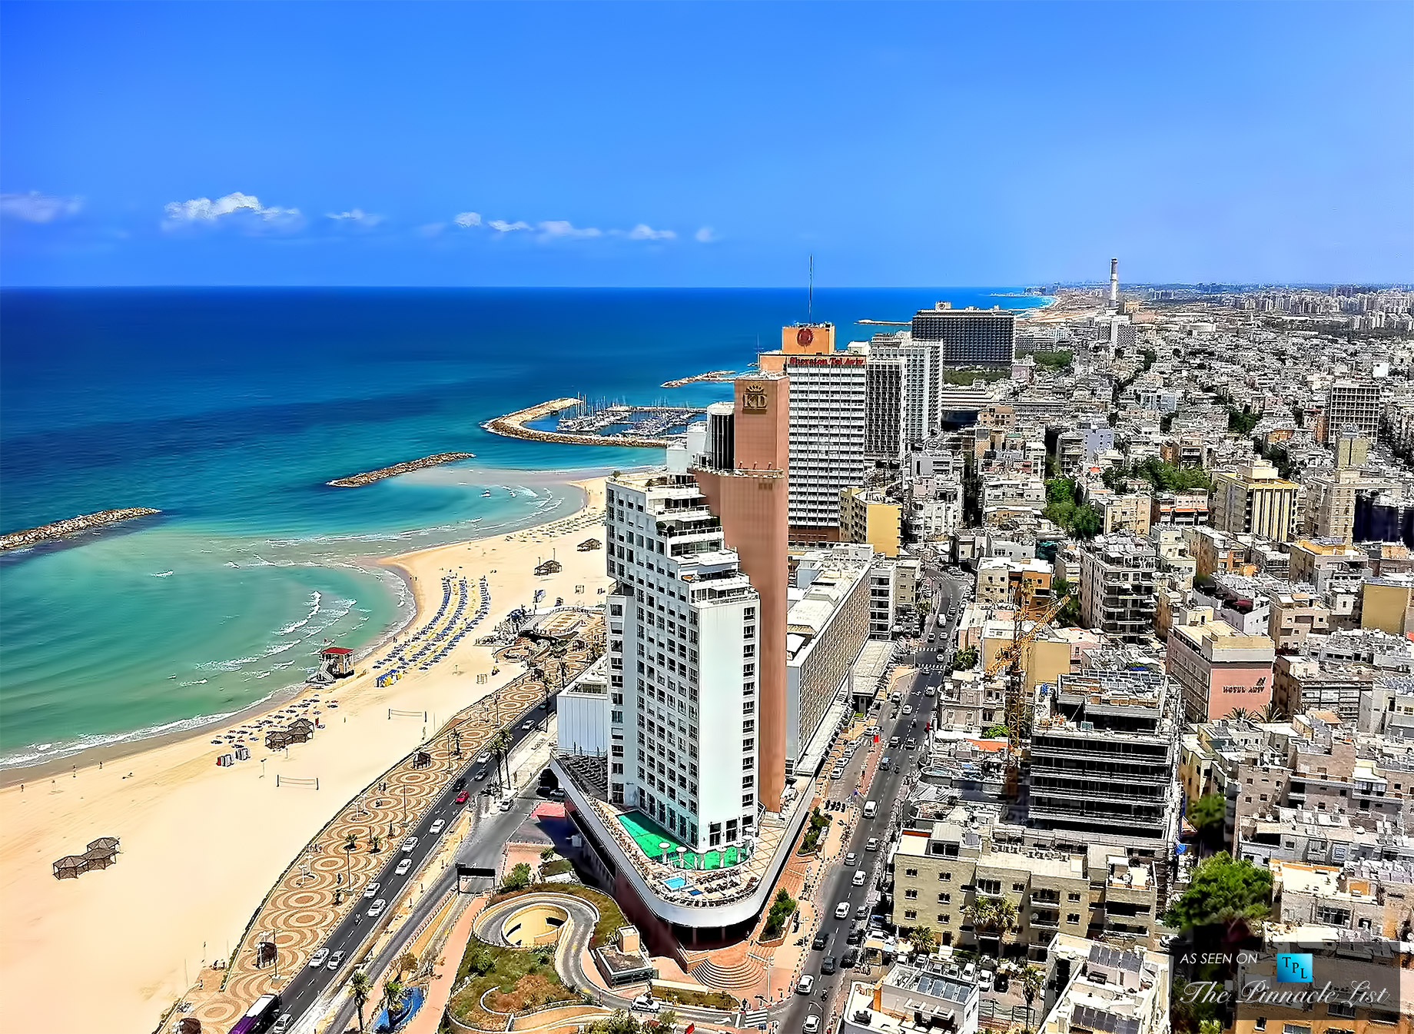
Notes:
Tel Aviv

Slide 5
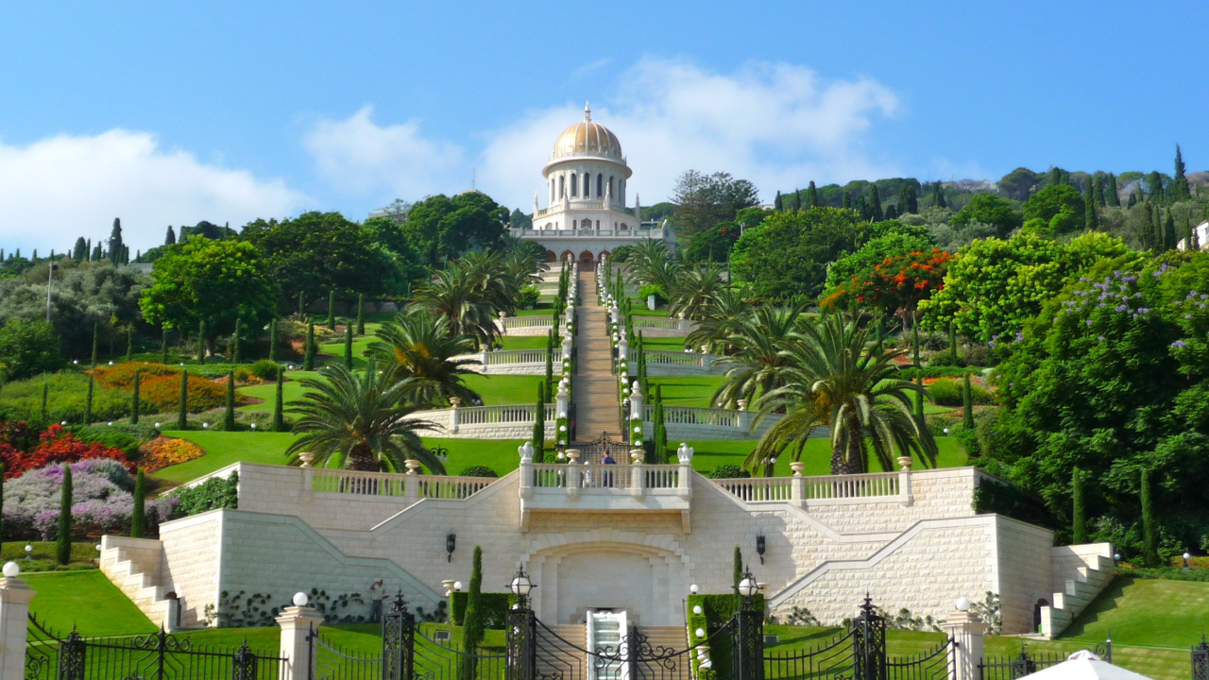
Notes:
Bahai’I Temple, Haifa

Slide 6
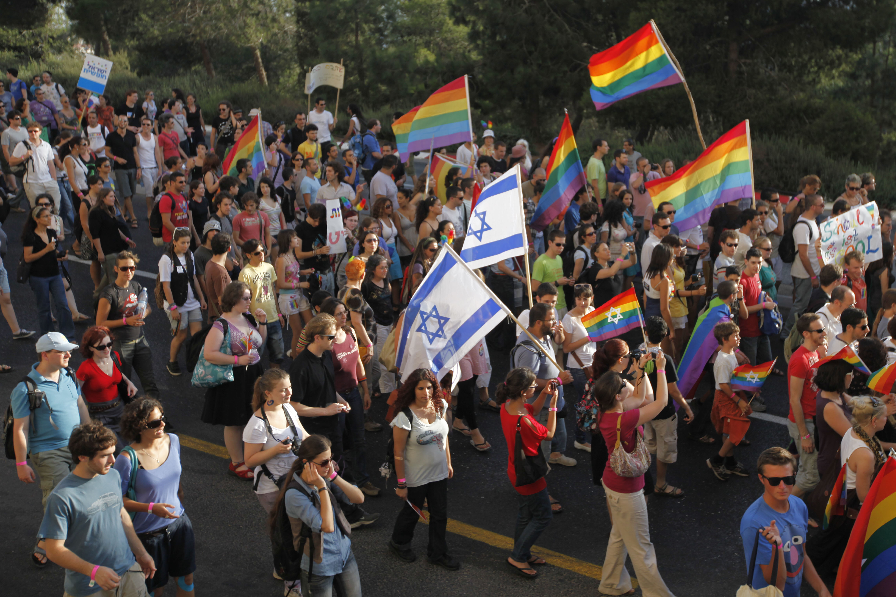
Notes:
Pride march, Tel Aviv

Slide 7
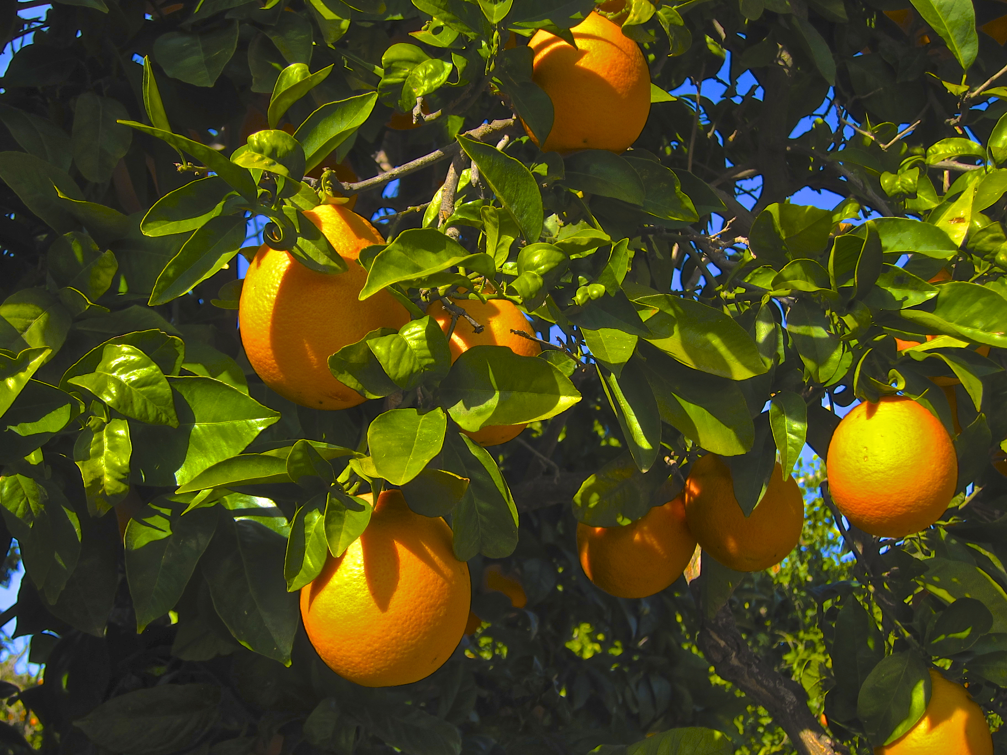
Notes:
Jaffa Oranges

Slide 8
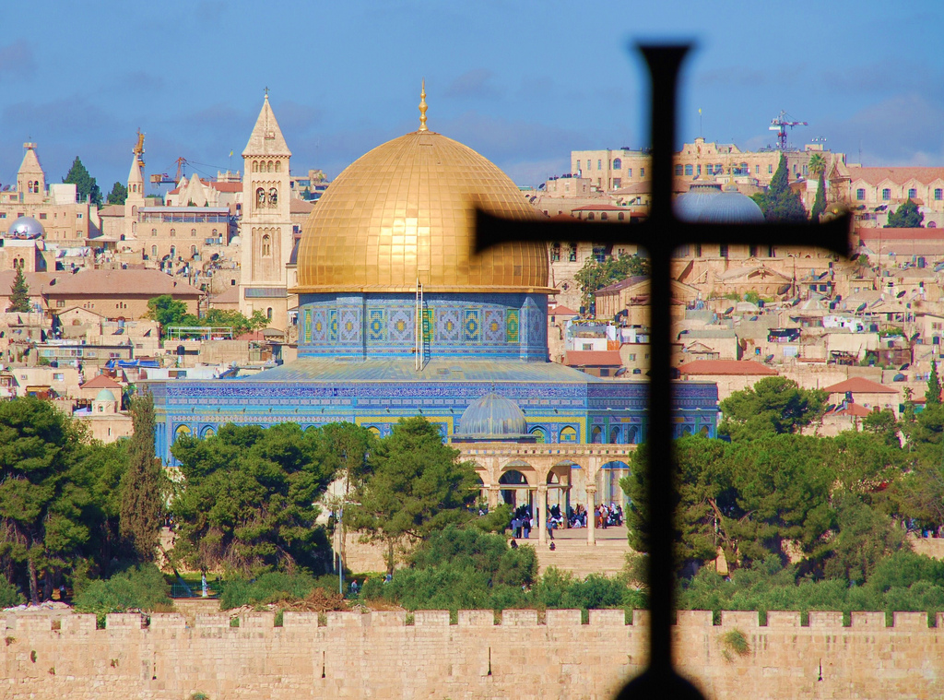
Welcome to our
Collective
Worship

Slide 9
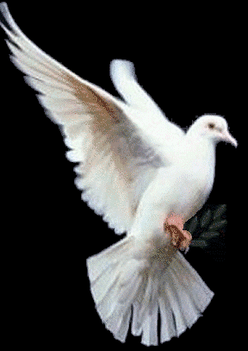
The Lord is here.
His spirit is with us!

Slide 10
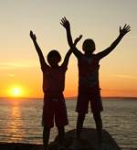
This is the day that the Lord has made.
We will rejoice and be glad in it!

Slide 11
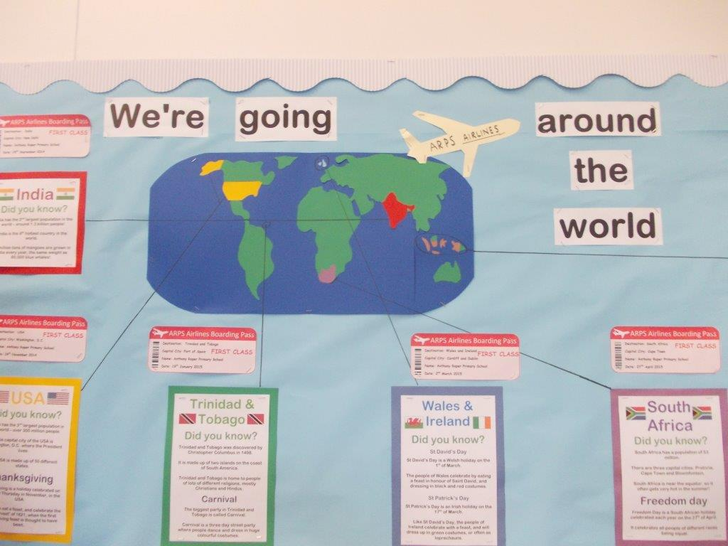

Slide 12
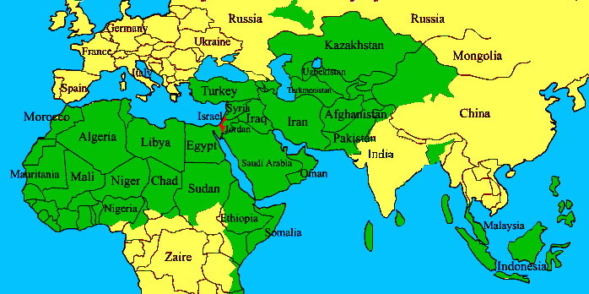

Slide 13
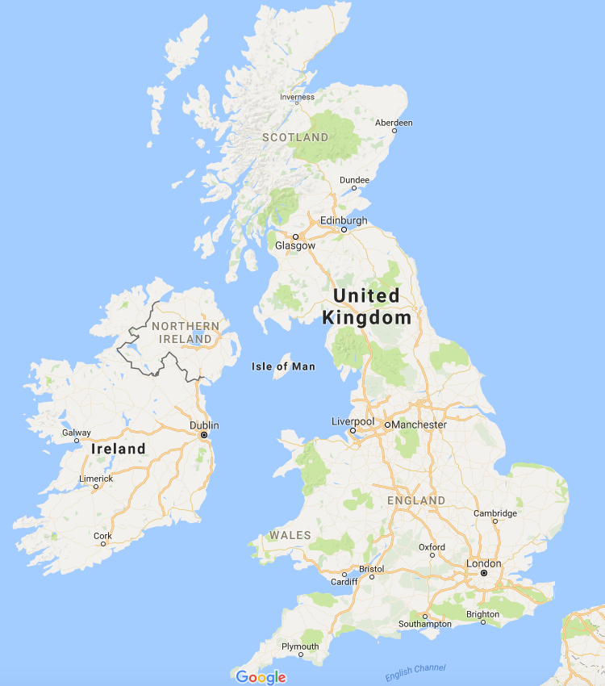
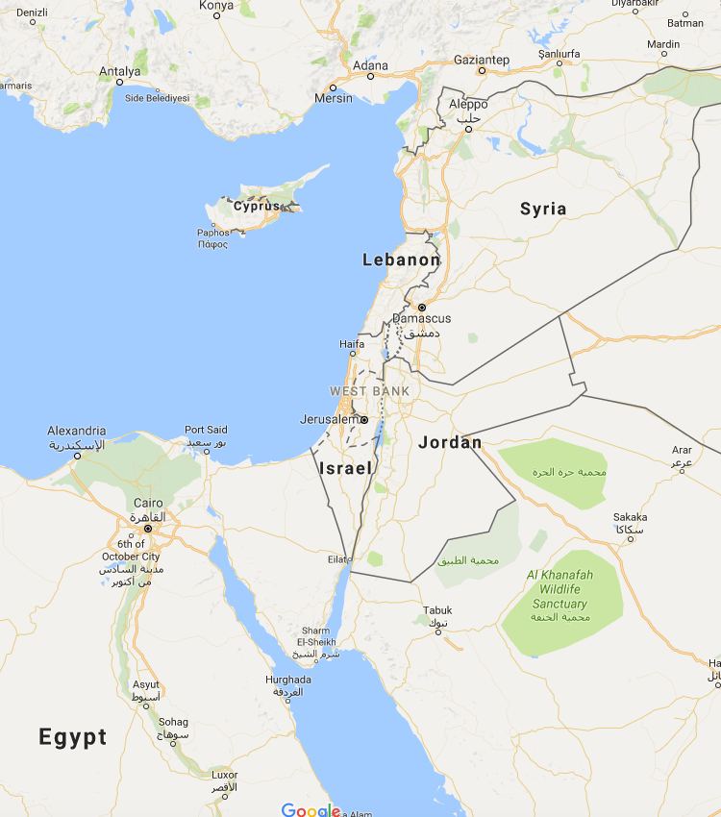
Notes:
Israel is a lot smaller than Britain

Slide 14
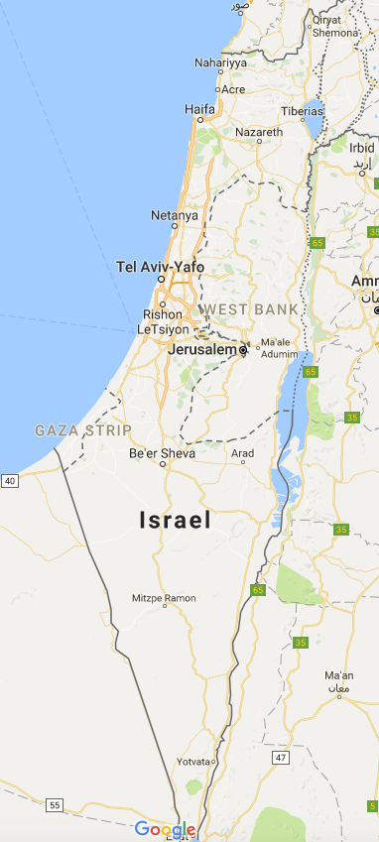
Notes:
Israel and the Occupied Palestinian Territories

Slide 15
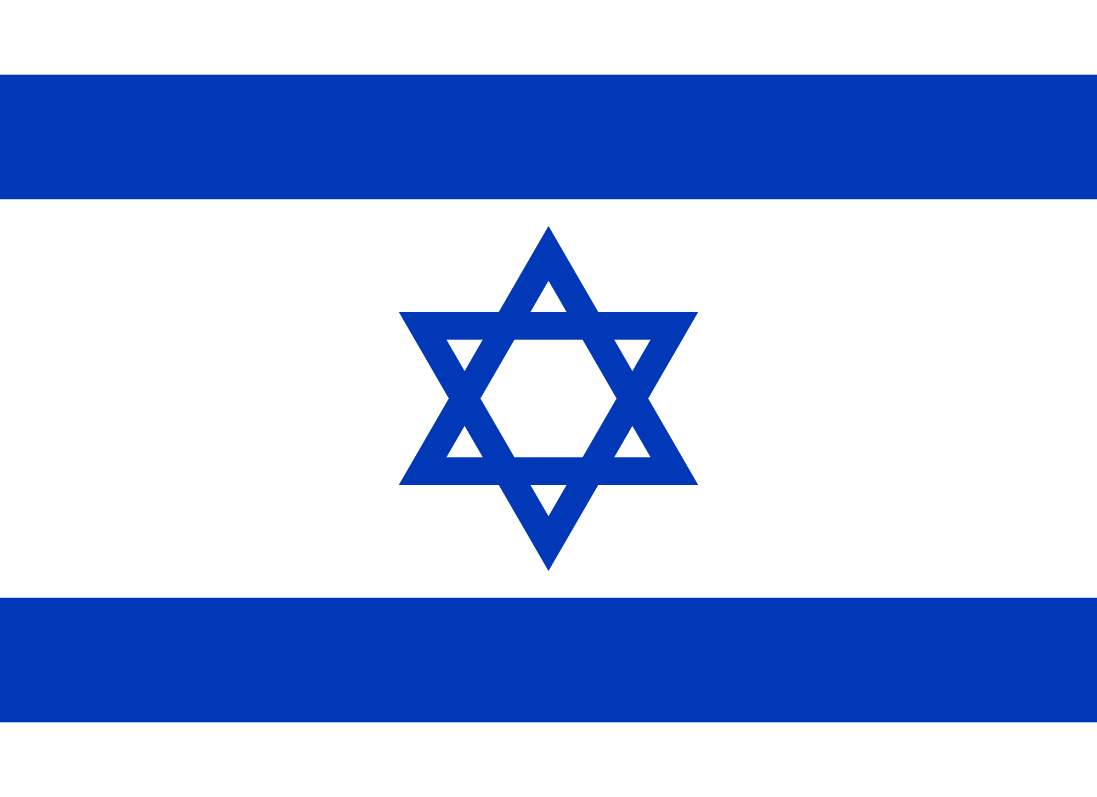
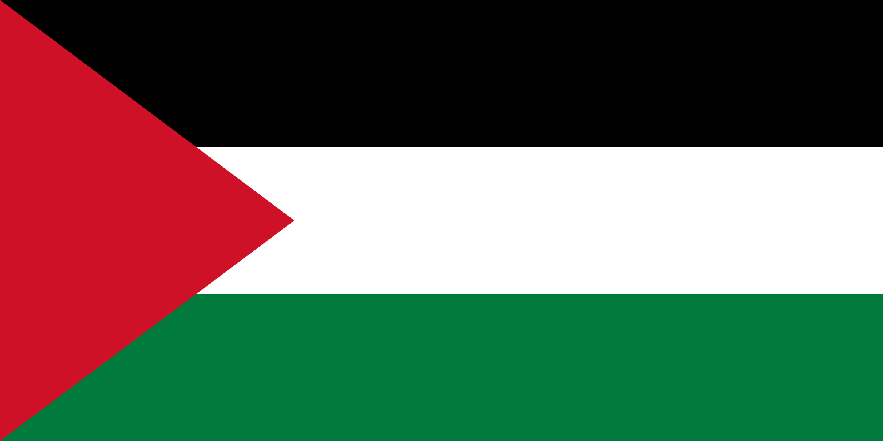
Two Countries
Israel
Palestine

Slide 16
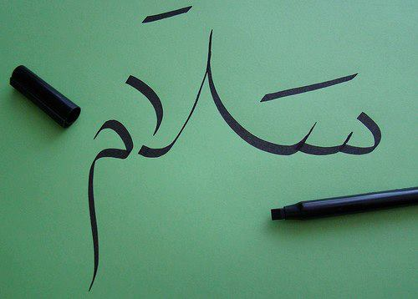
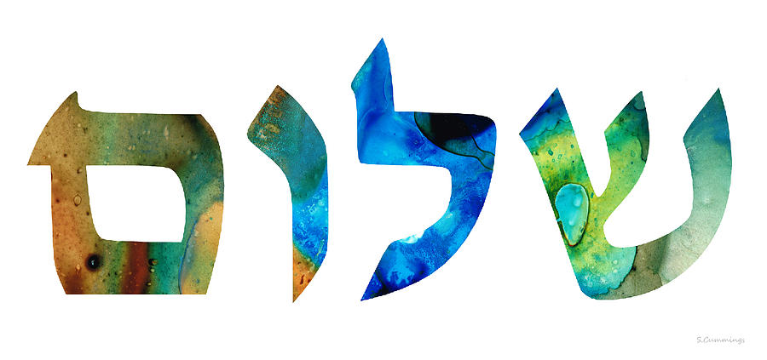
Two Languages
Hebrew
Arabic

Slide 17
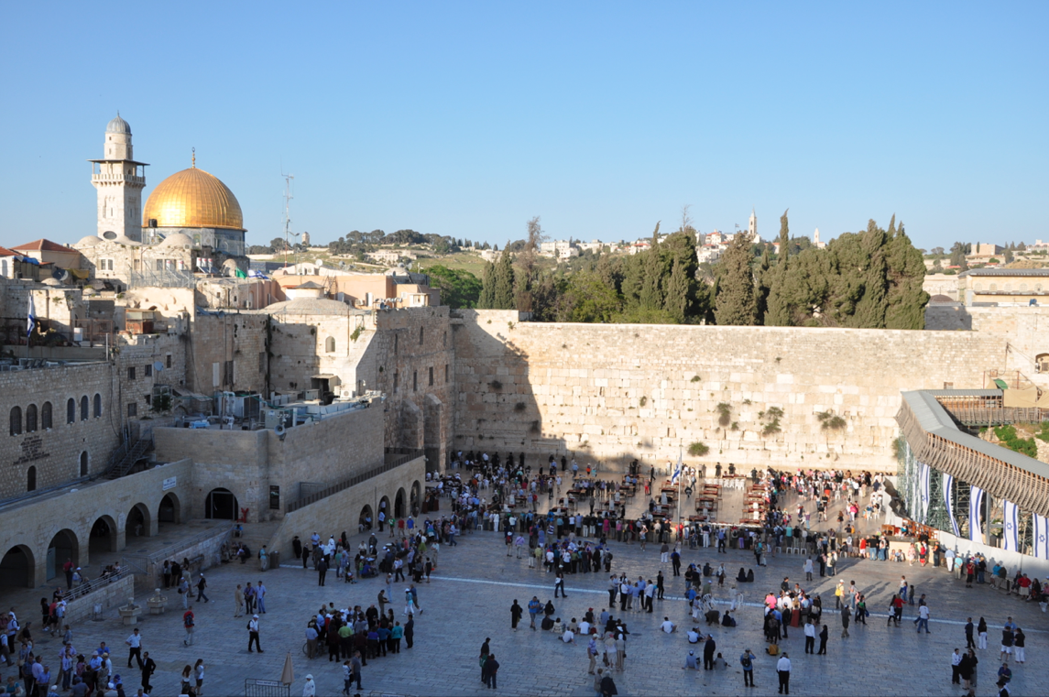
Jerusalem

Slide 18
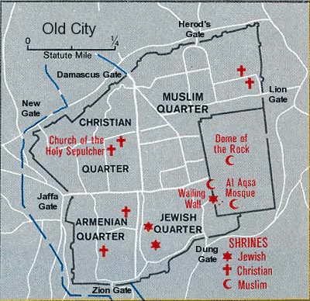
Jerusalem

Slide 19
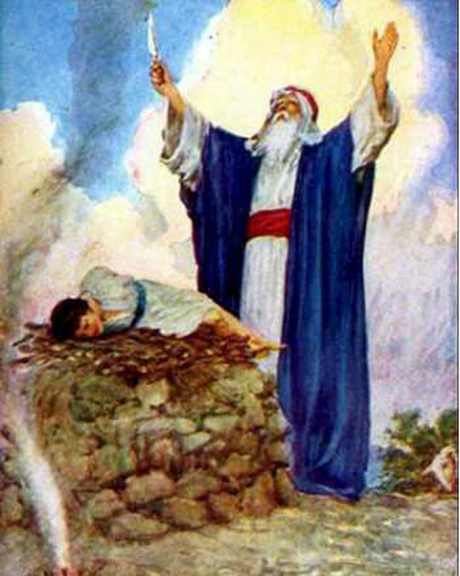
Abraham
Notes:
Abraham is the father of the three religions Judaism, Christianity and Islam
The binding of Isaac is said to have taken place on the site of the Temple Mount in Jerusalem

Slide 20
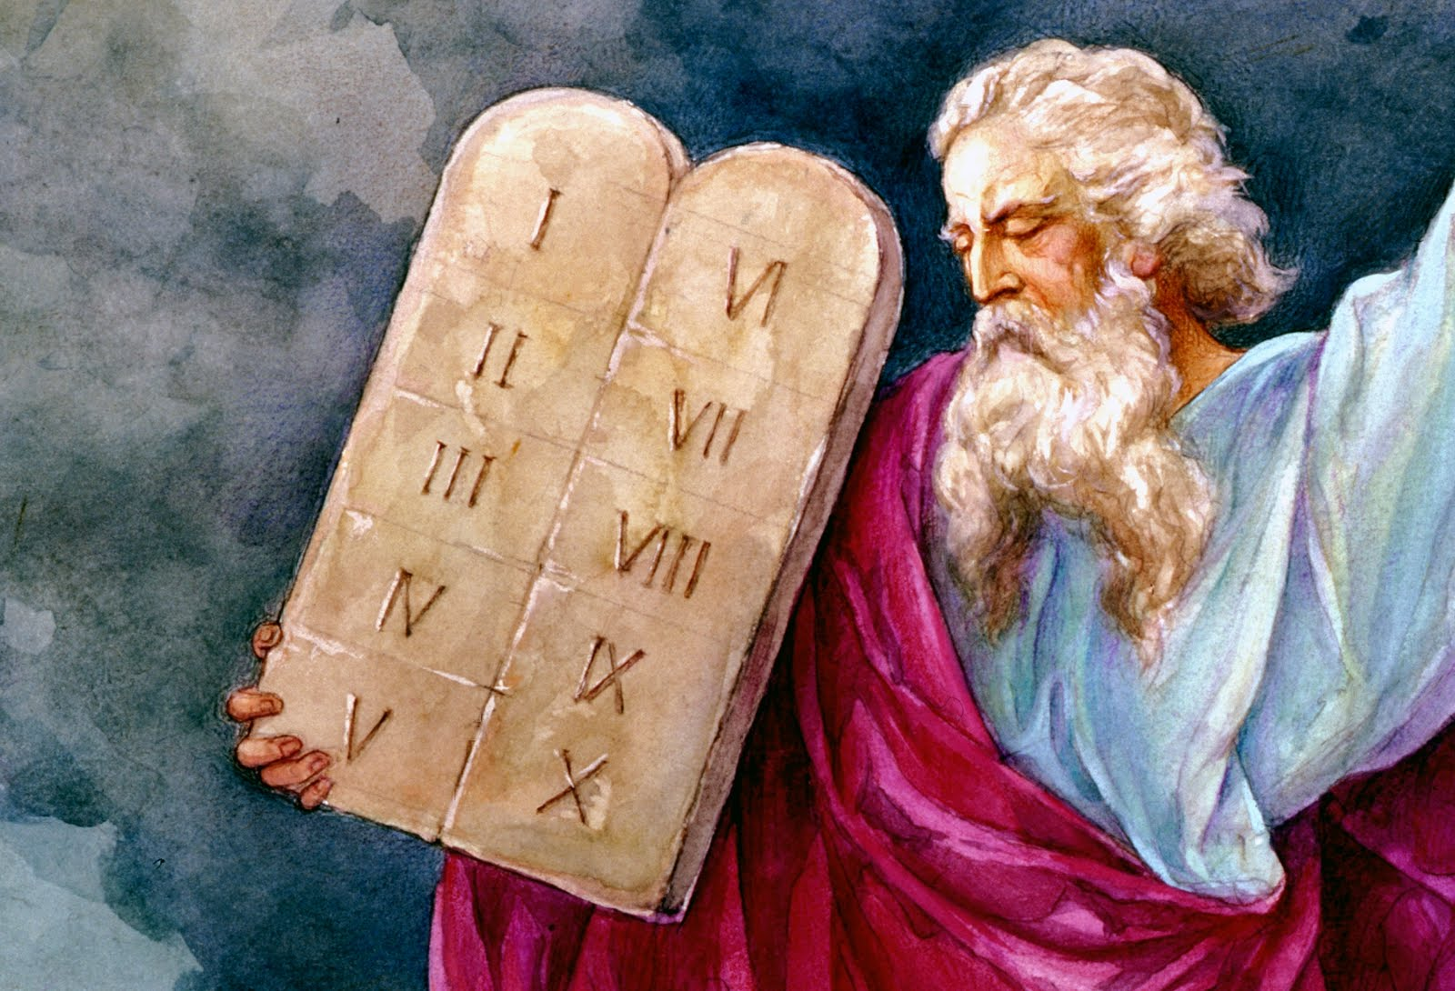
Moses
Notes:
Moses led the Israelites to the “Promised Land” but was not allowed to enter

Slide 21
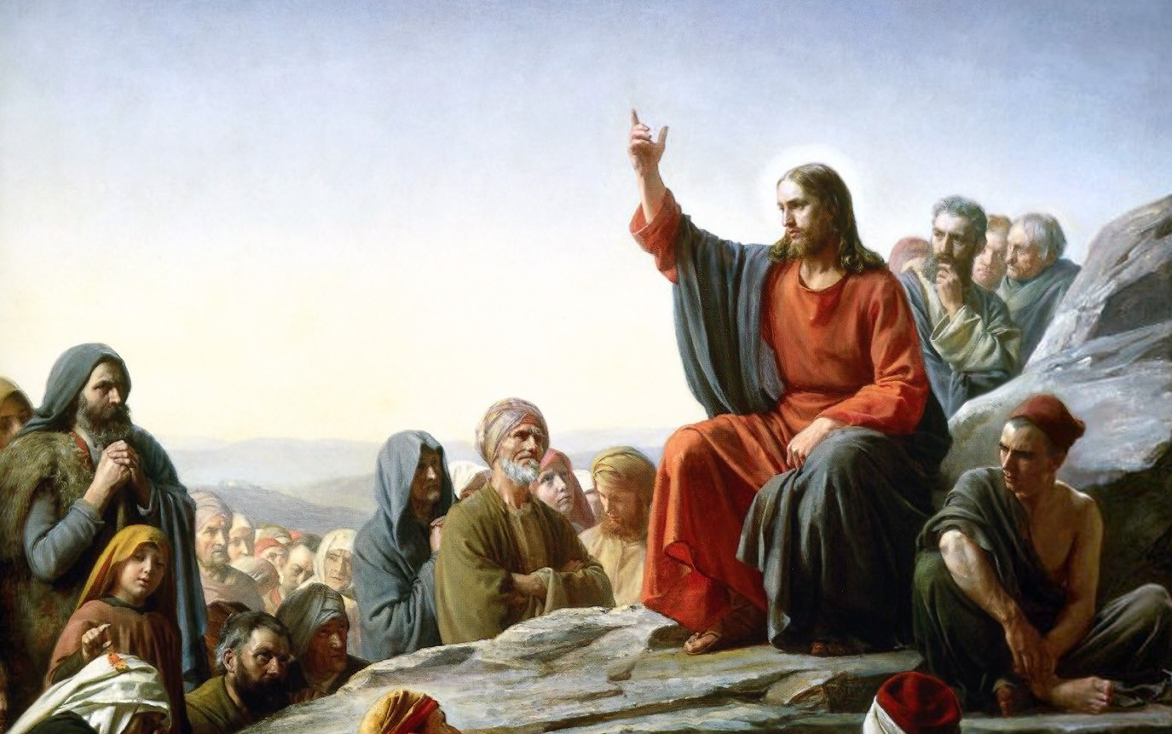
Jesus
Notes:
Jesus was born in Bethlehem and lived and died in Jerusalem
You can follow in his footsteps on the Stations of the Cross (Via Dolorosa)

Slide 22
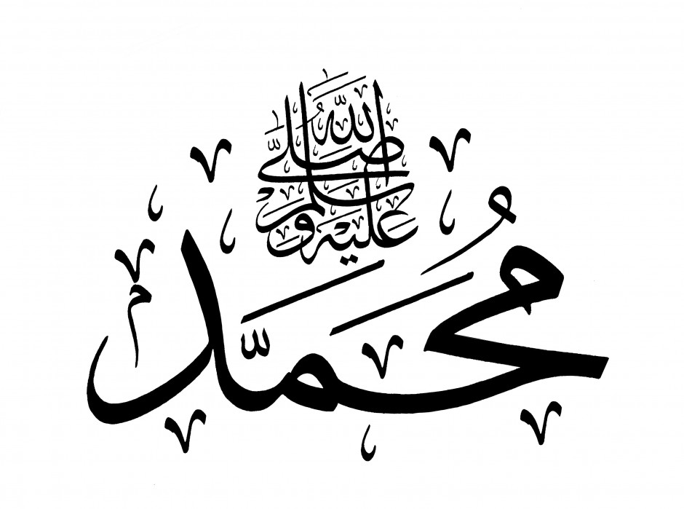
Muhammad
Notes:
Muhammad was taken from Mecca to Jerusalem in a single night and ascended to heaven

Slide 23
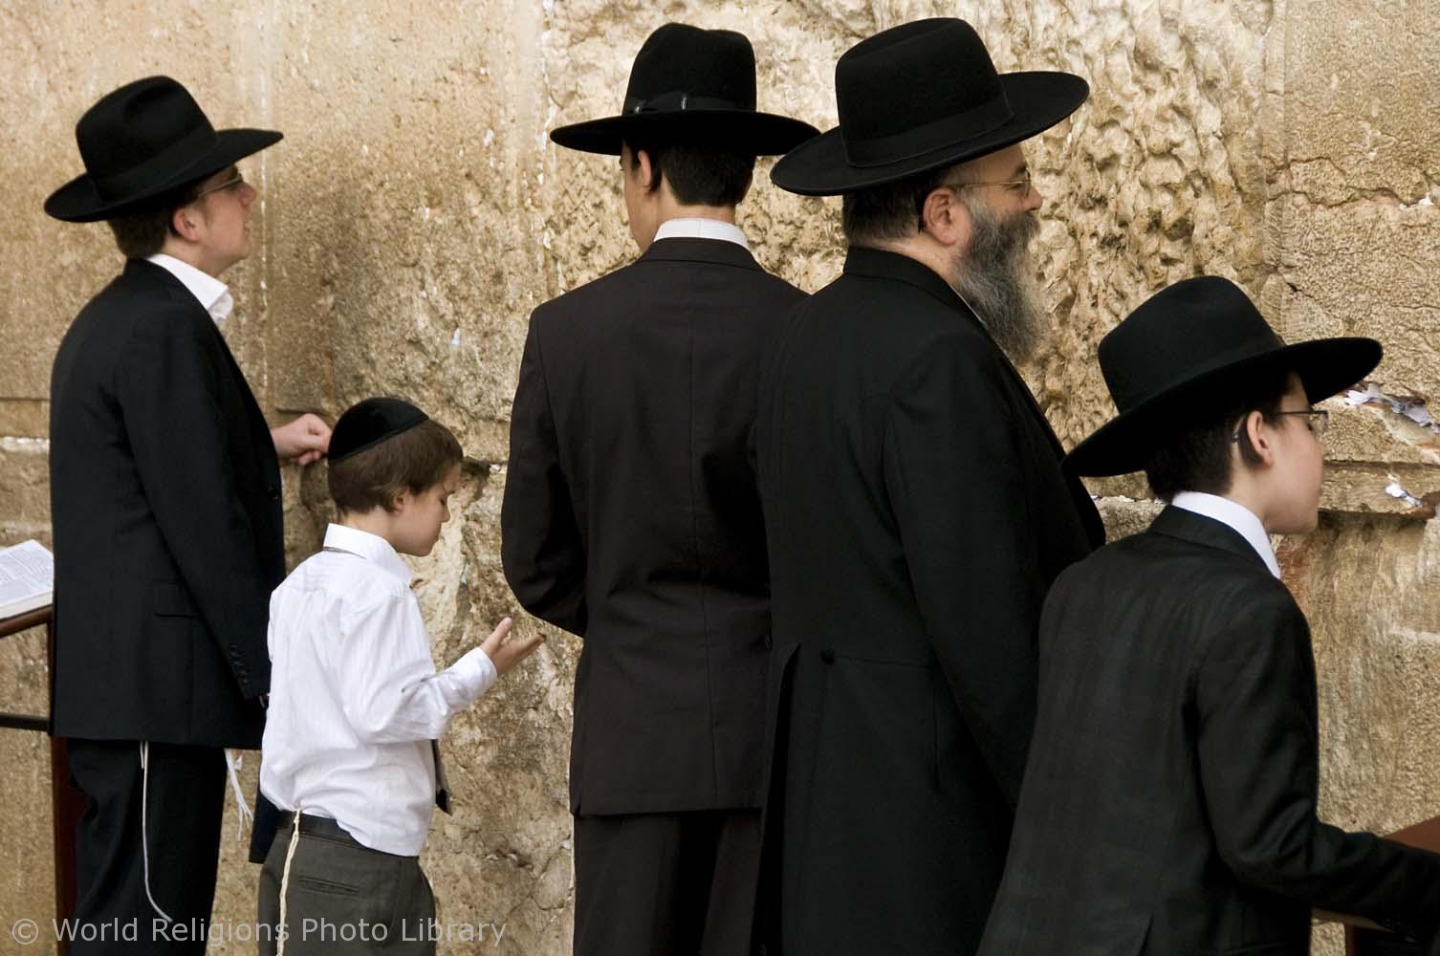
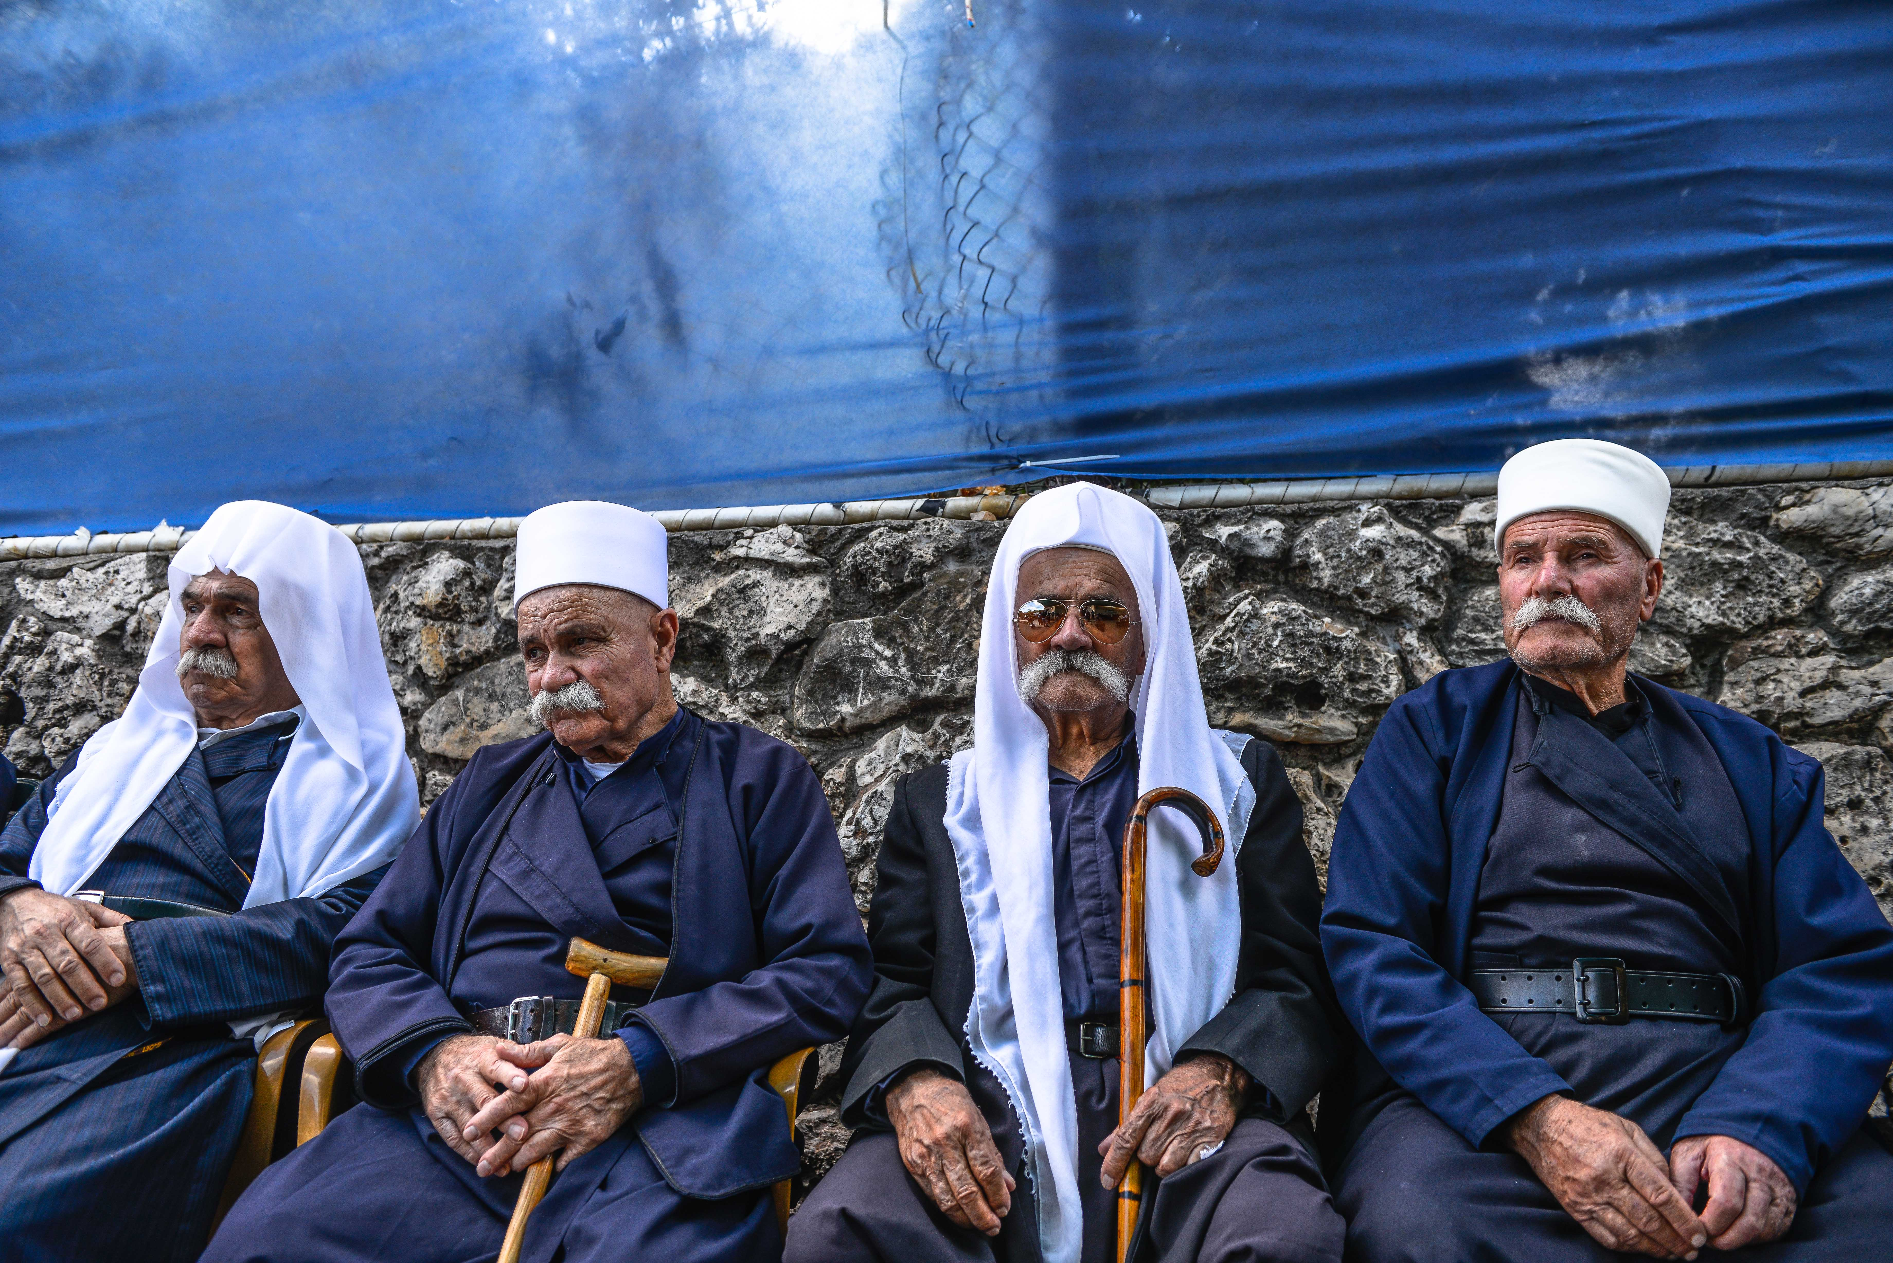
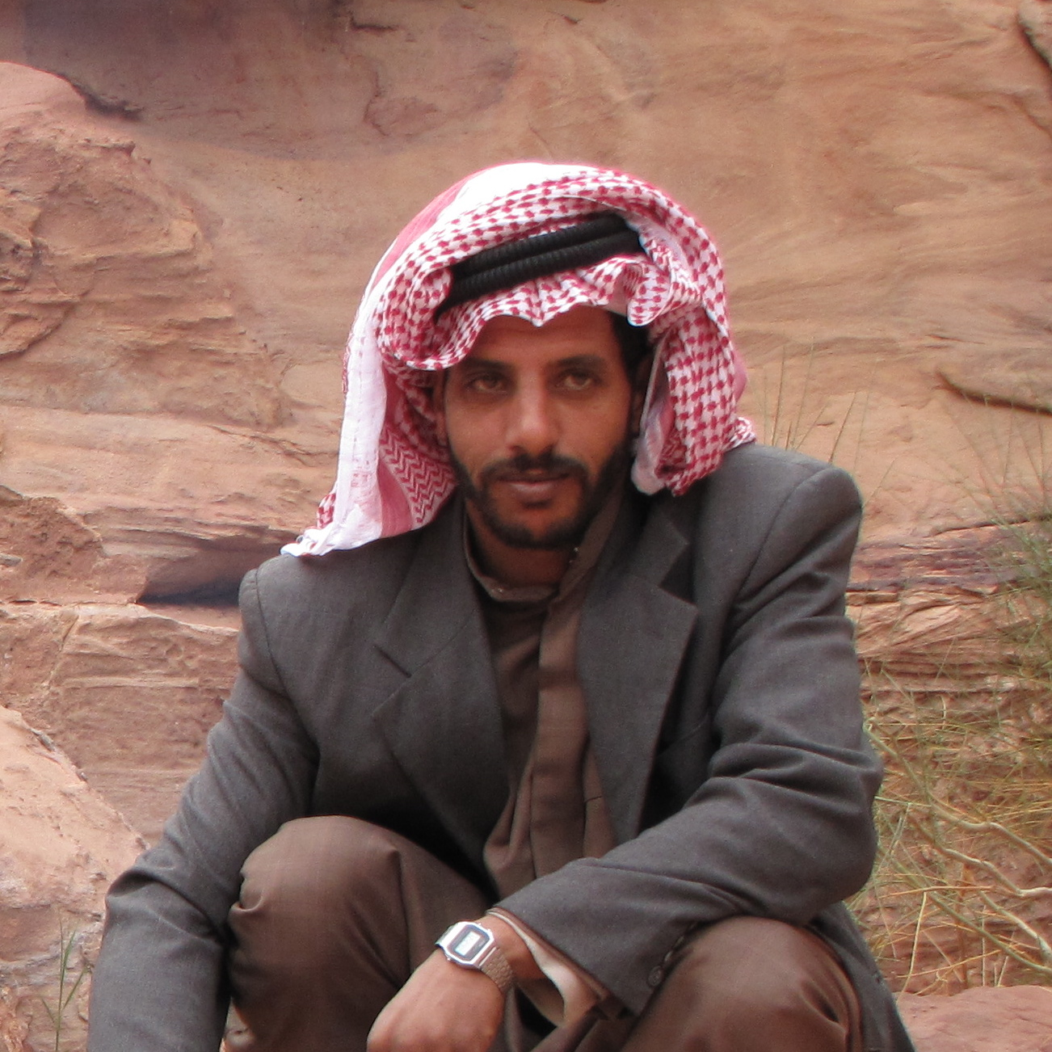
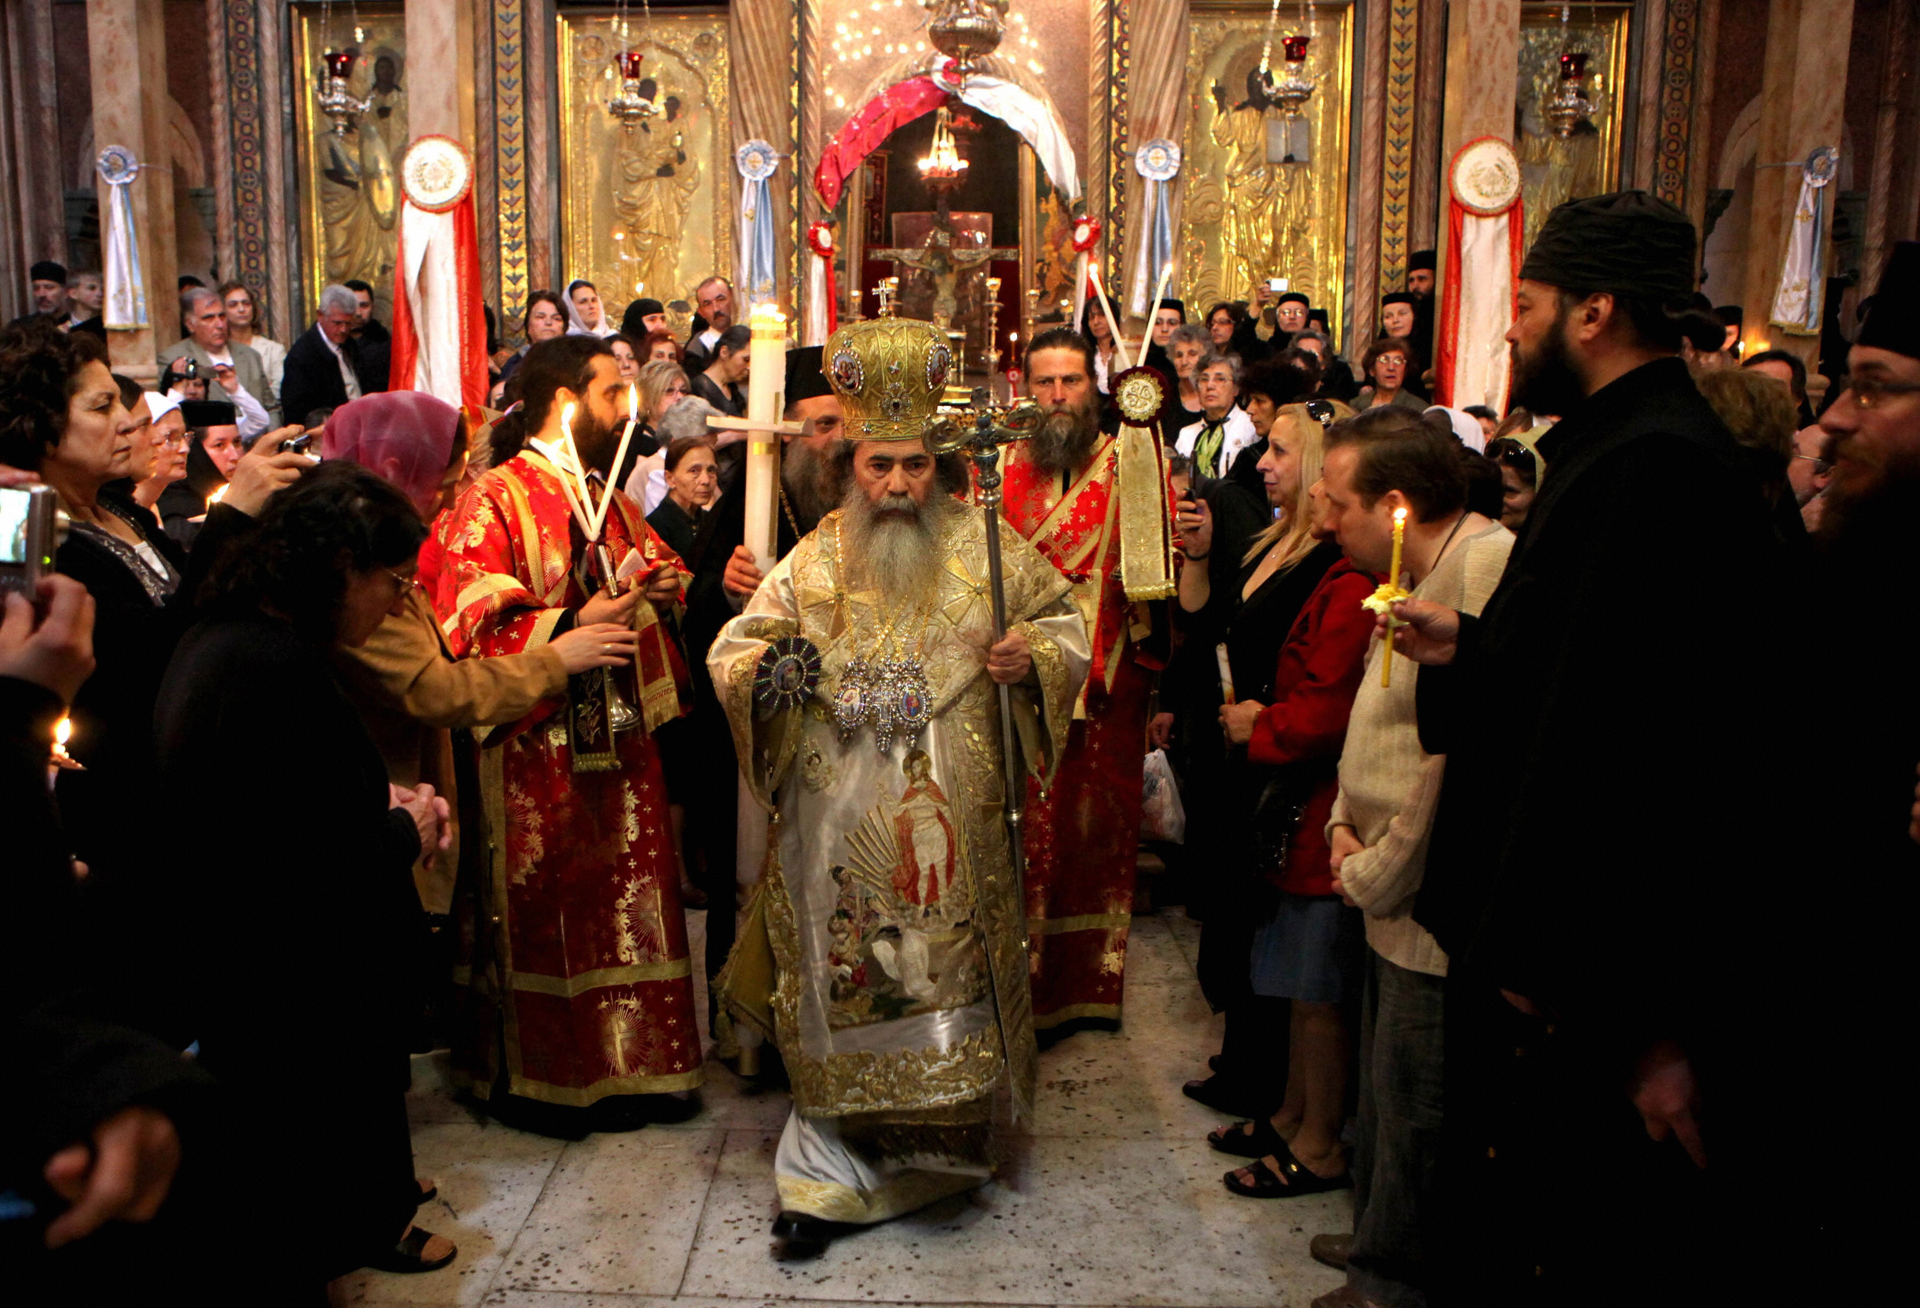
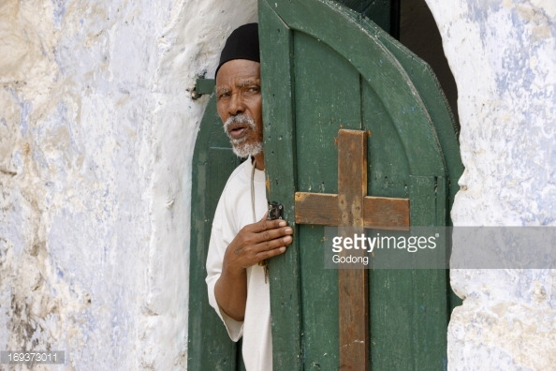
Notes:
Clockwise: Orthodox Jews; Druze; Ethiopian Coptic; Greek Orthodox; Bedouin (centre)

Slide 24
Religion

Slide 25
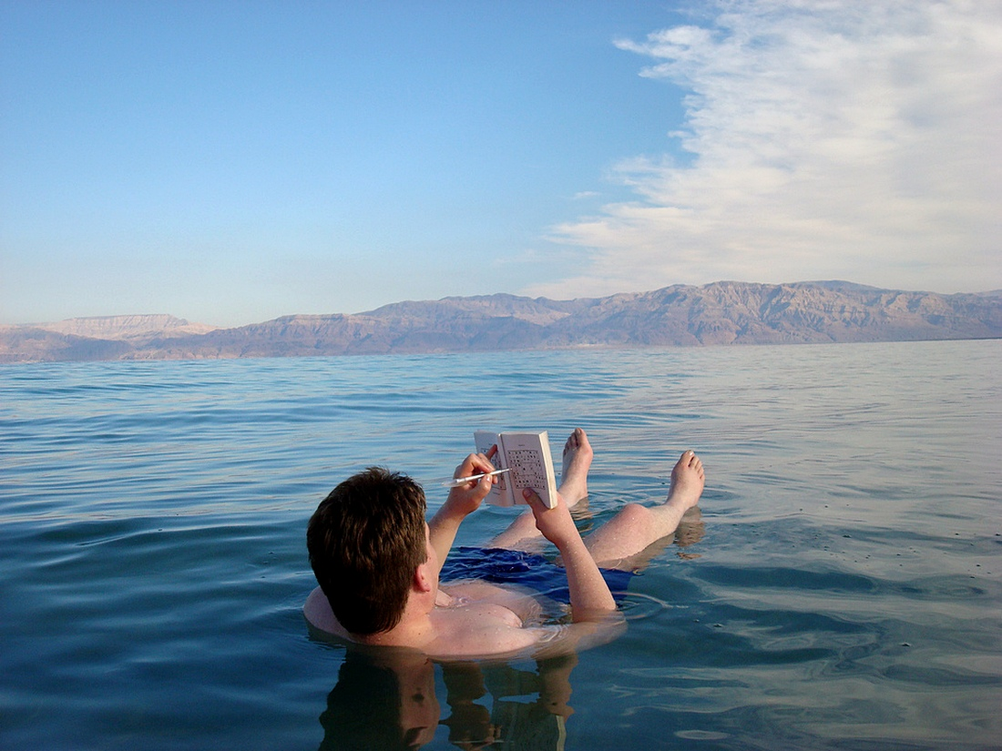
The Dead Sea
Notes:
The Dead Sea is so salty, you can float in it

Slide 26
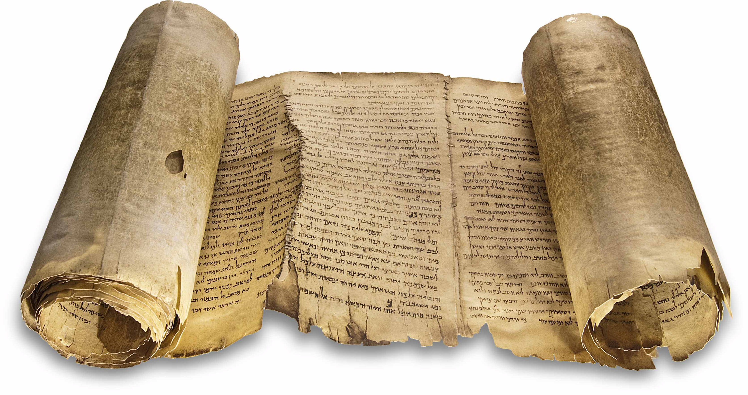
The Dead Sea Scrolls
Notes:
Written 200BC – 68AD
Discovered in 1946-56
Texts from hebrew scriptures and other books
For example Deuteronomy, Psalms, Isaiah

Slide 27
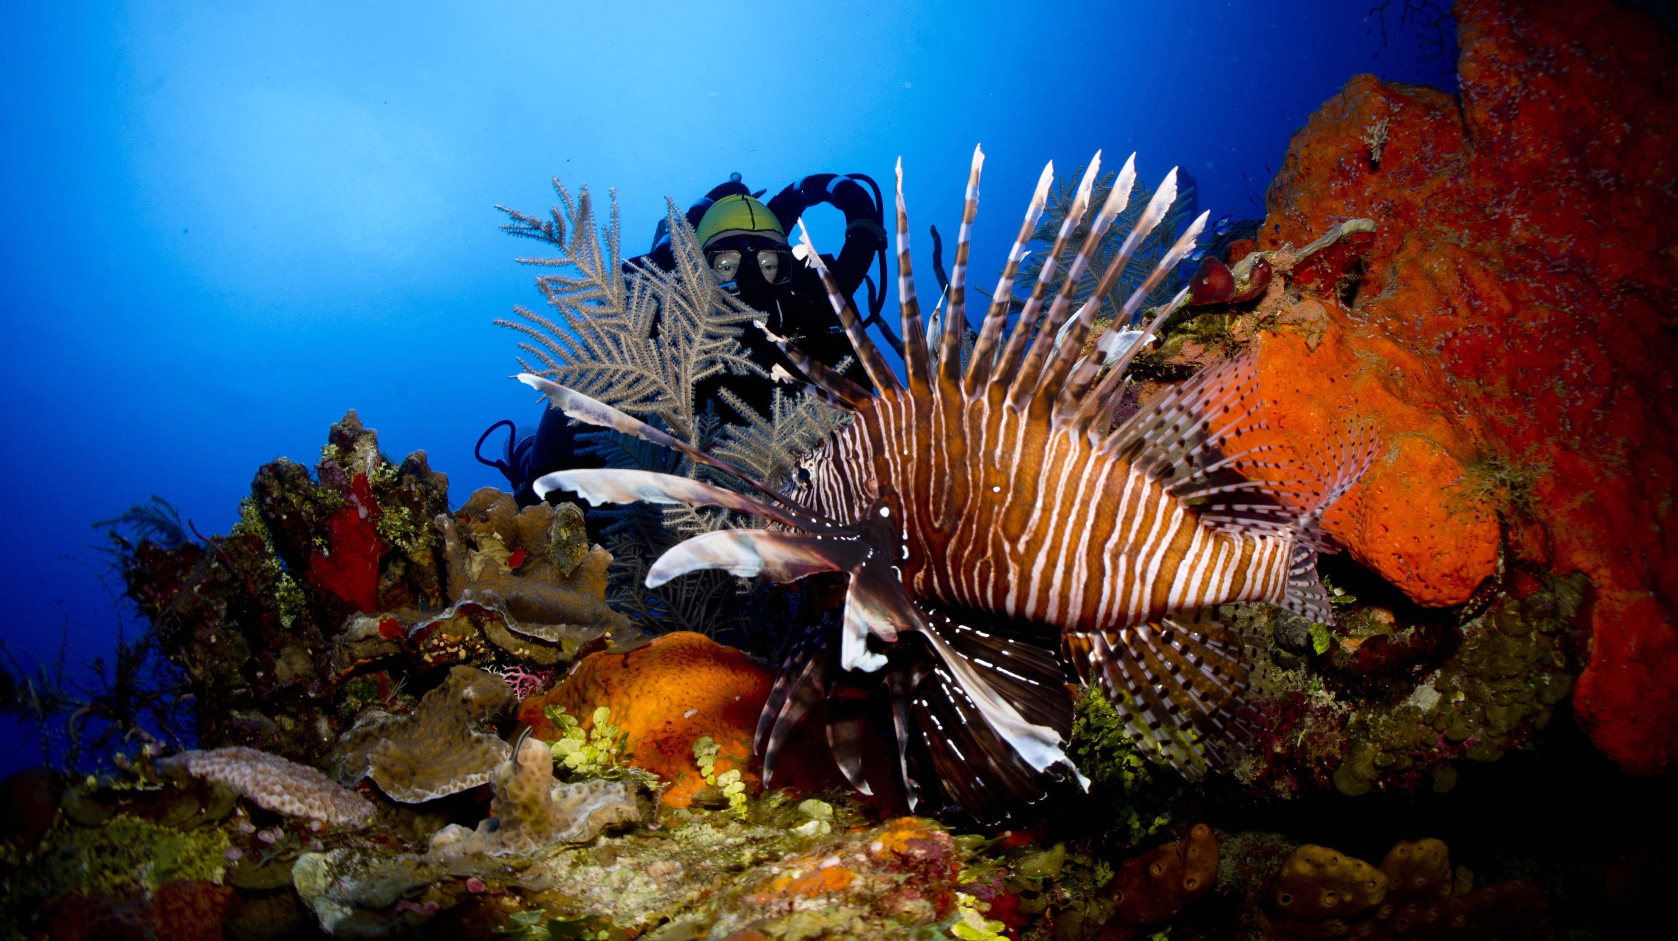
Coral Reefs
Notes:
The Red Sea (Eilat)

Slide 28
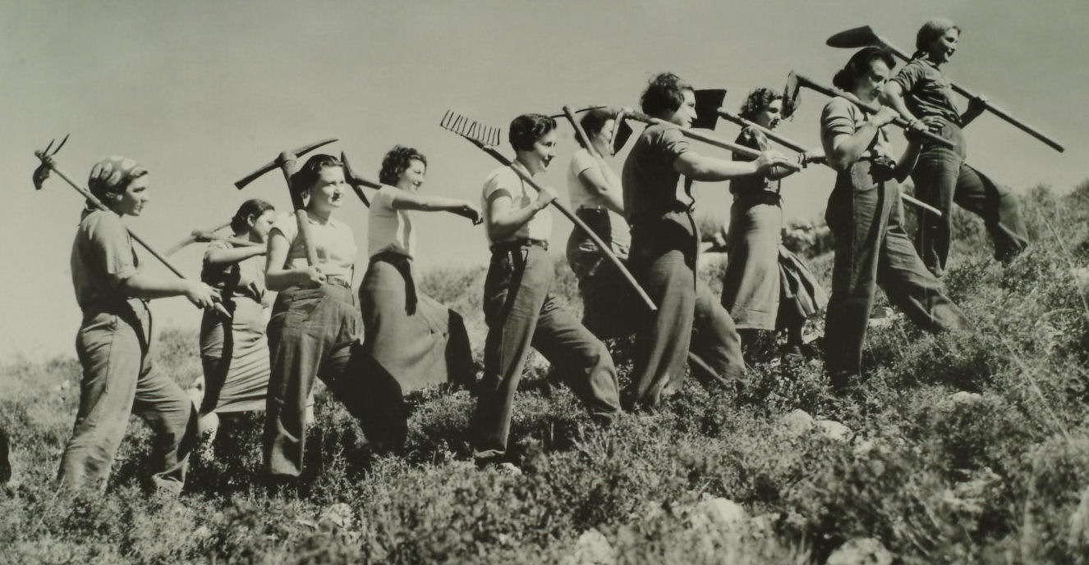
Kibbutz

Slide 29
Immigration

Slide 30
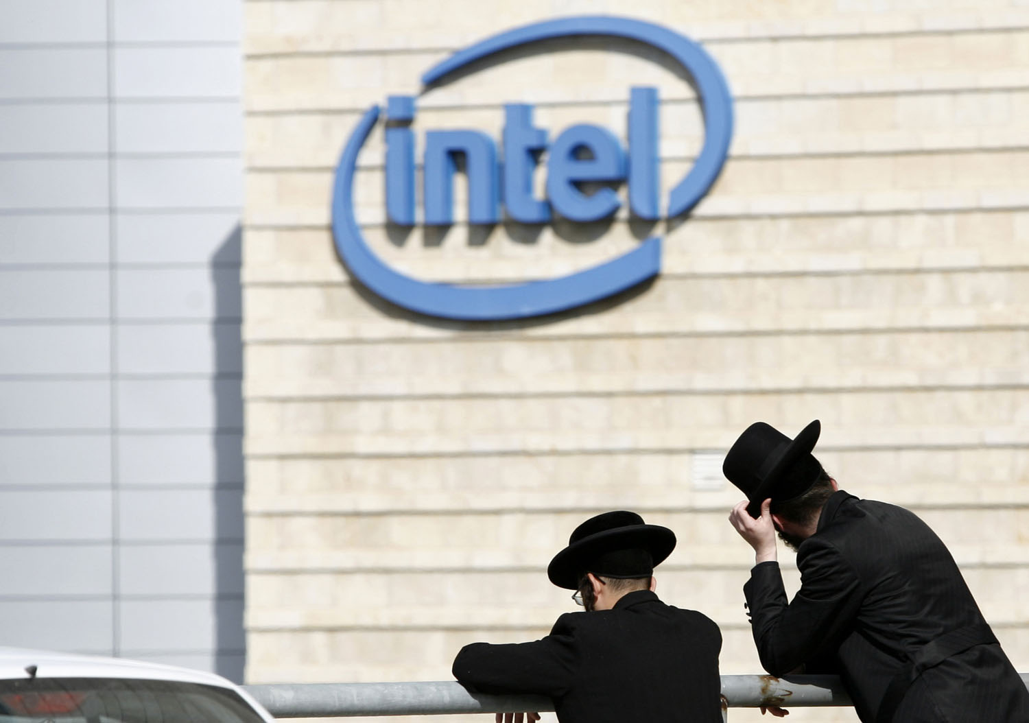
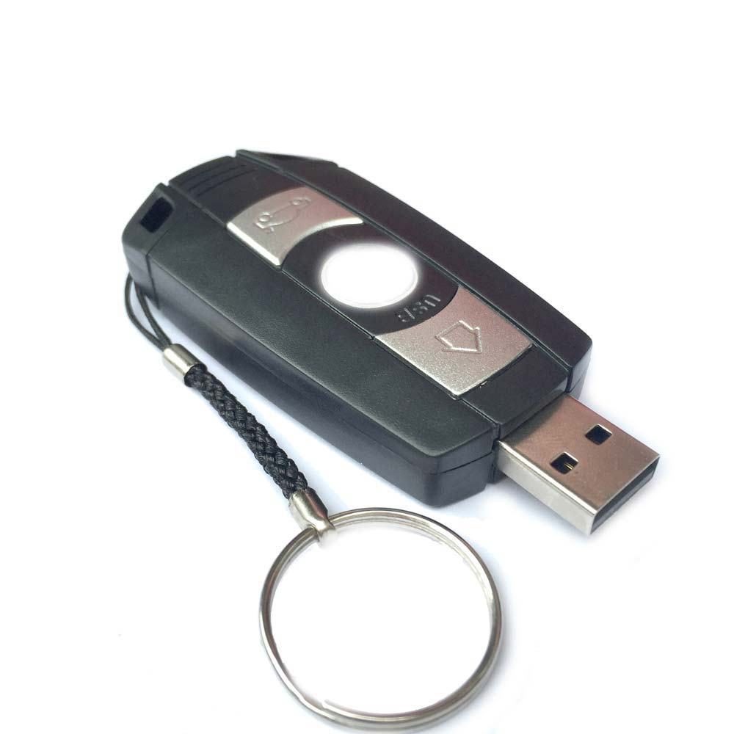
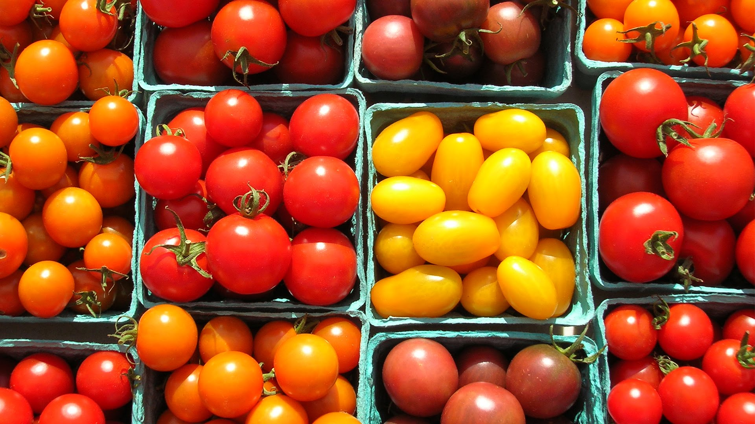
Notes:
Most Intel computer processors are designed and manufactured in Israel
USB memory sticks and cherry tomatoes are both Israeli inventions

Slide 31
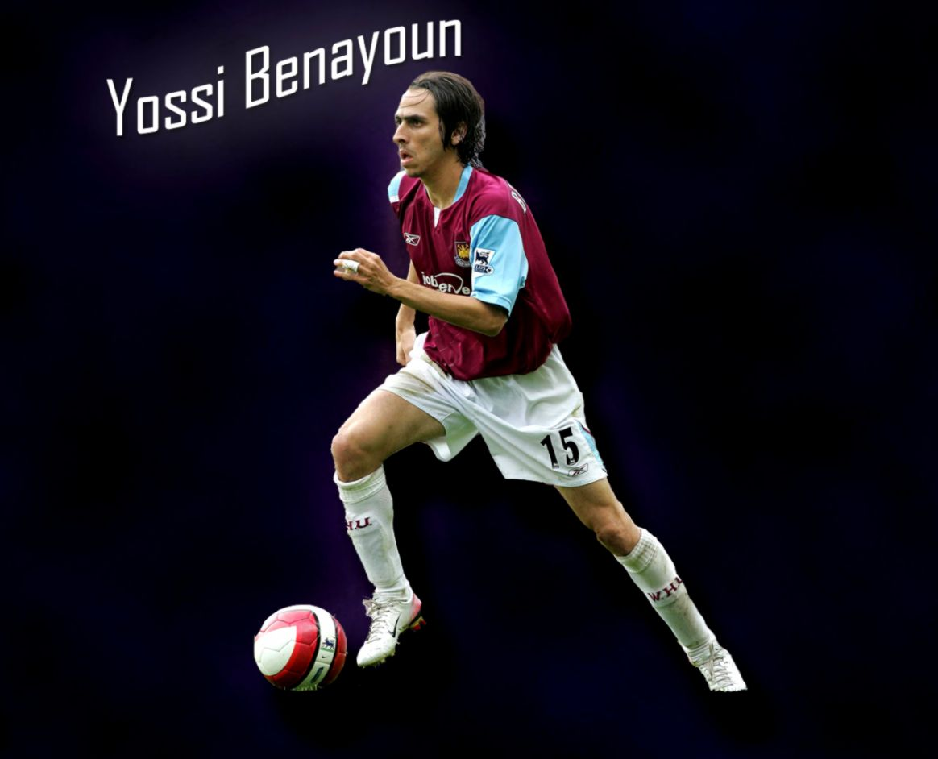
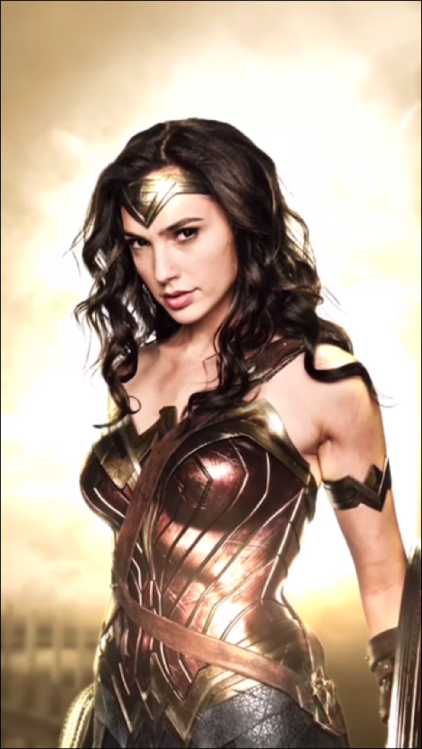
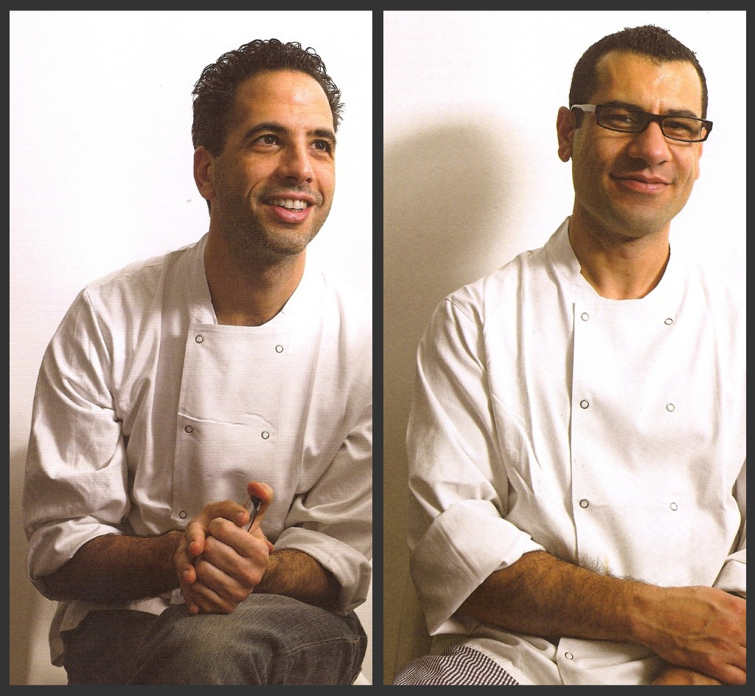
Notes:
Famous Israelis: Yossi Benayoun, Gal Gadot (Wonder Woman), Yotam Ottolenghi and Sami Tamimi

Slide 32
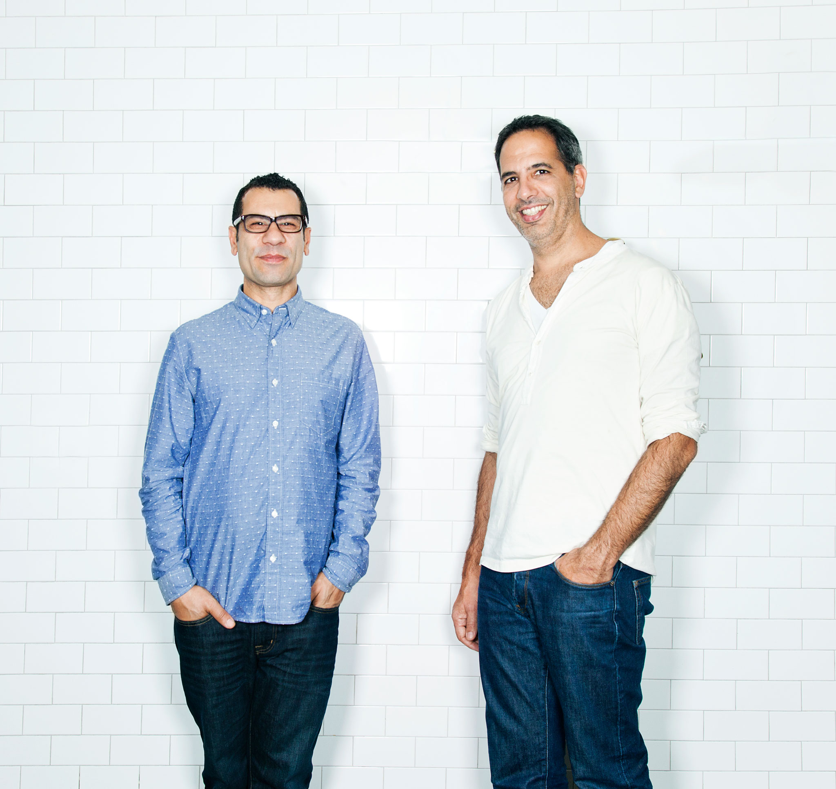
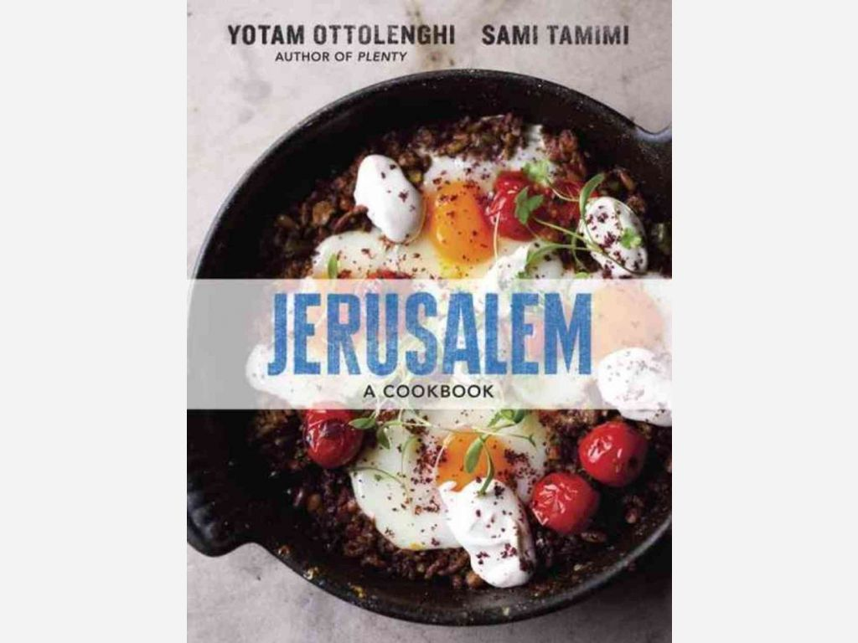
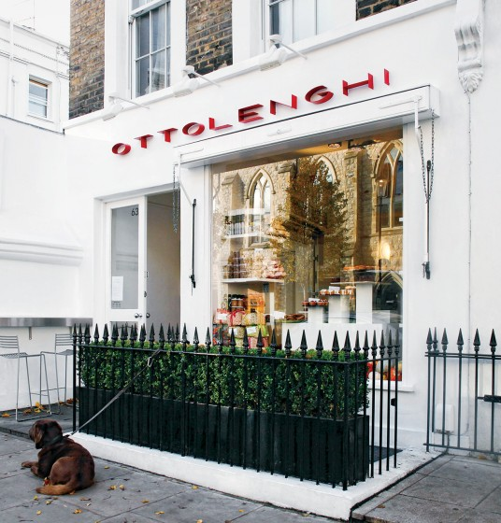
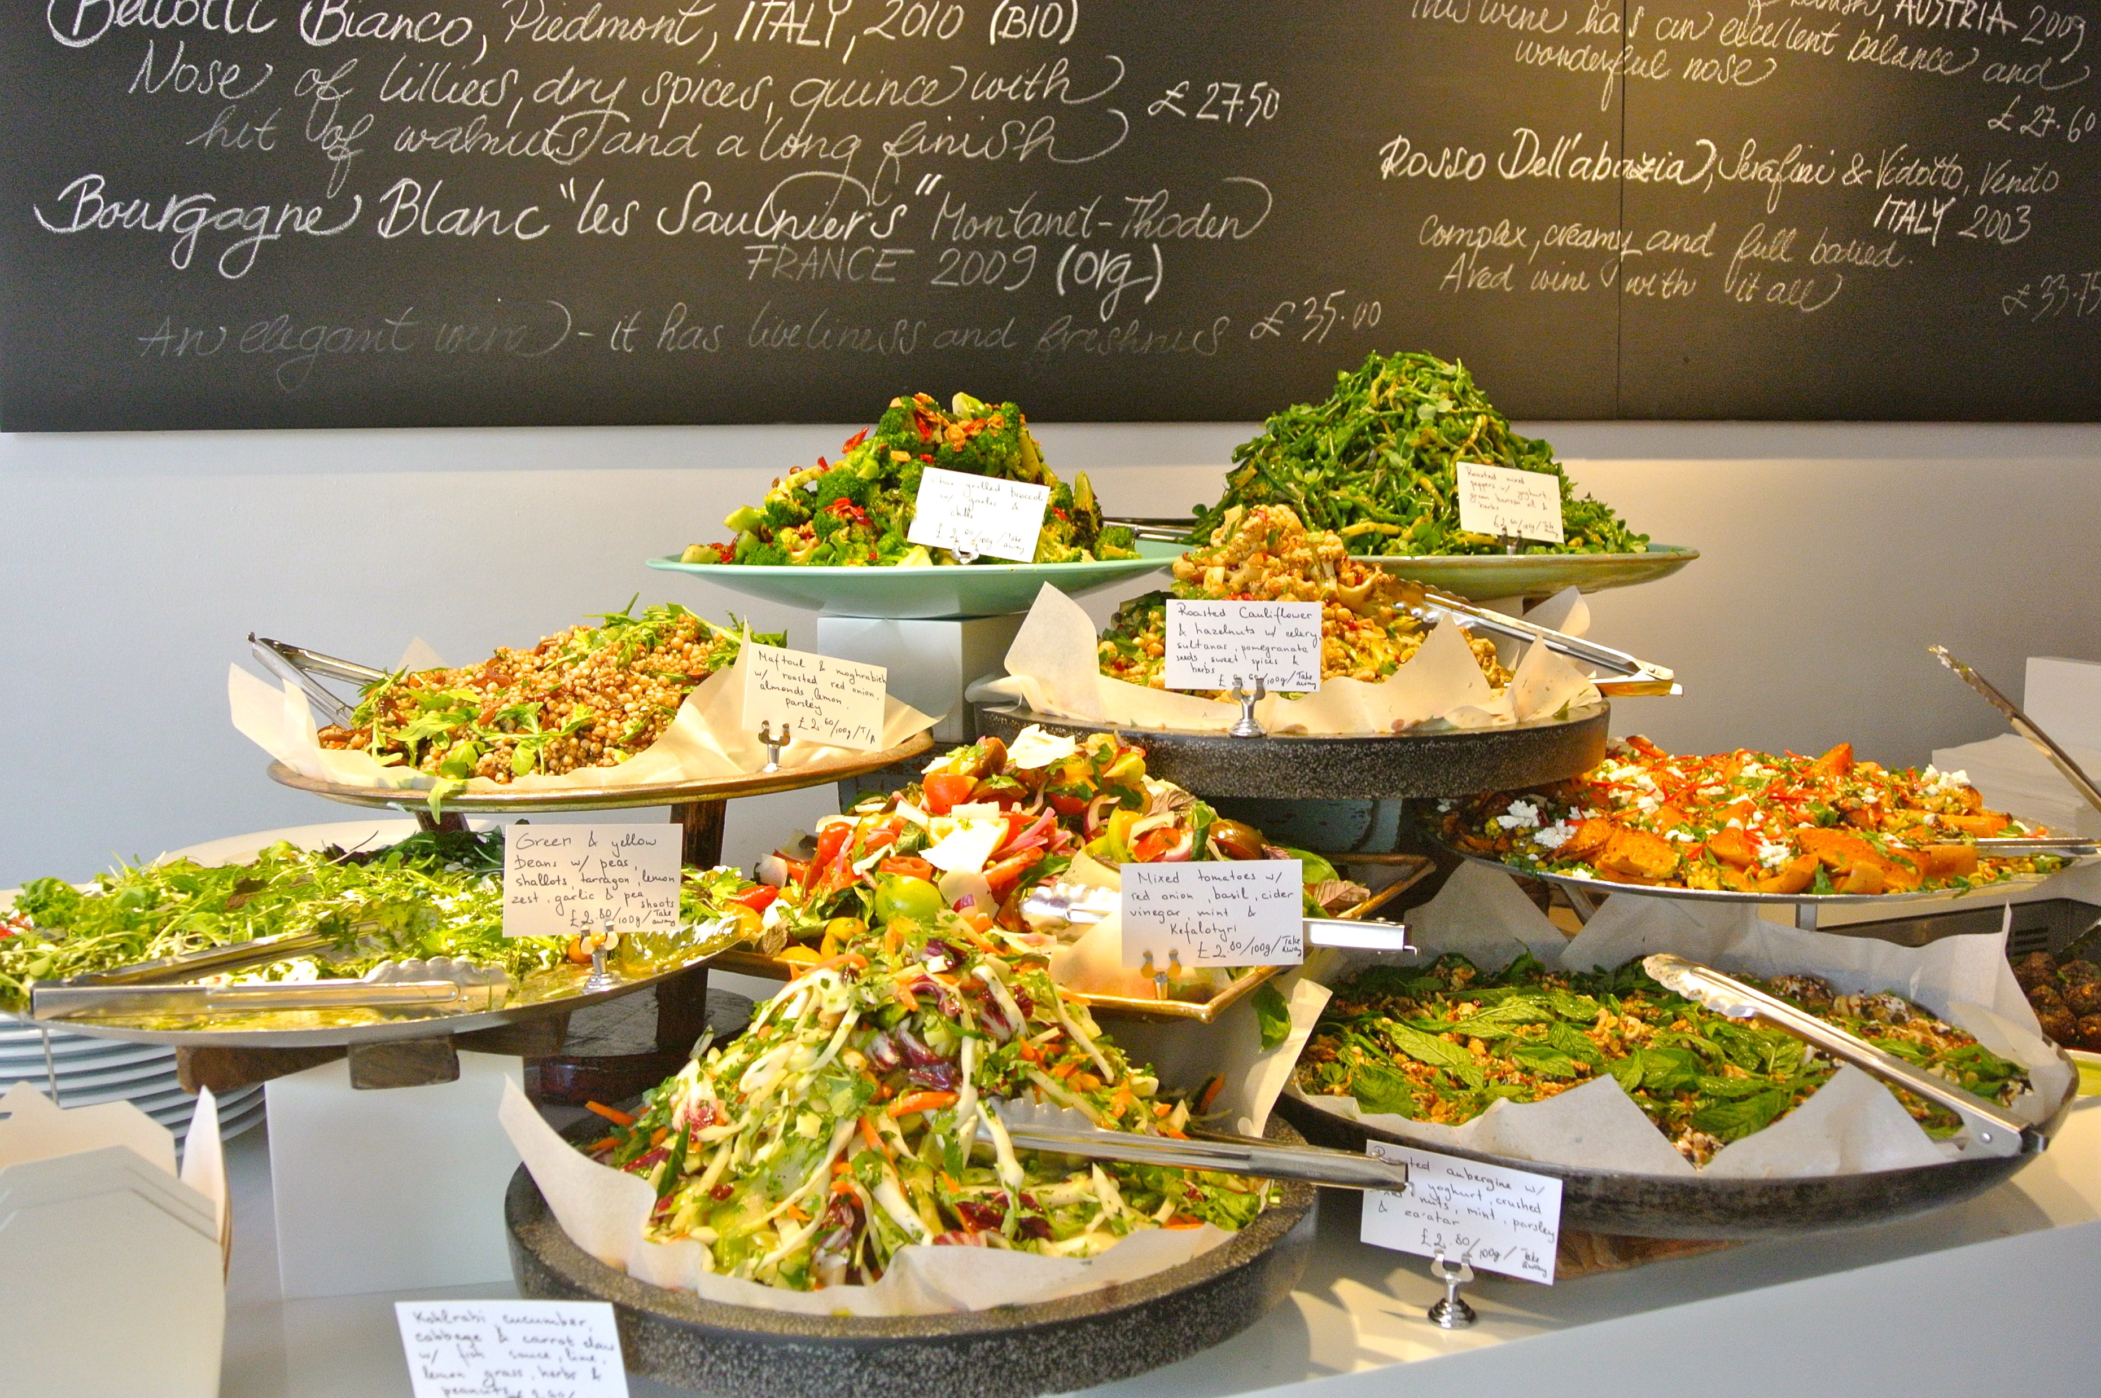
Notes:
Yotam Ottolenghi is Jewish, Sami Tamimi is an Arab.
http://www.independent.co.uk/news/people/profiles/how-we-met-sami-tamimi-yotam-ottolenghi-8857491.html

Slide 33
He's got the whole world
in his hands, He's got the whole world
in his hands, He's got the whole world
in his hands, He's got the whole world
in his hands.

Slide 34
He's got Israel
in his hands, He's got Palestine
in his hands, He's got Israel
in his hands, He's got the whole world
in his hands.

Slide 35
He's got the whole world
in his hands, He's got the whole world
in his hands, He's got the whole world
in his hands, He's got the whole world
in his hands.

Slide 36
The Prayers

Slide 37
We go from here to learn to work together,
Working together to learn!

